Slide 1
HCI
V.O. Gallage - ICT/20/842
G.N.U. Lakshan - ICT/20/878
M.K.S.T. Sampath - ICT/20/923
K.N.N.C De Silva - ICT/20/826
A.M.A.N.K. Alagiyawanna – ICT/20/804
A.G.H.M. Madhubhashini - ICT/20/881
J.M.Y.R. Bandara - ICT/20/812N.P.N.C. Nugawela - ICT/20/897
B.A.S.I. Jayawardana - ICT/20/860
Group No : 03
Tell Me Project Proposal

Slide 2




A Voice enabled Digital assistent
This
is
Tell Me Project Proposal

Slide 3
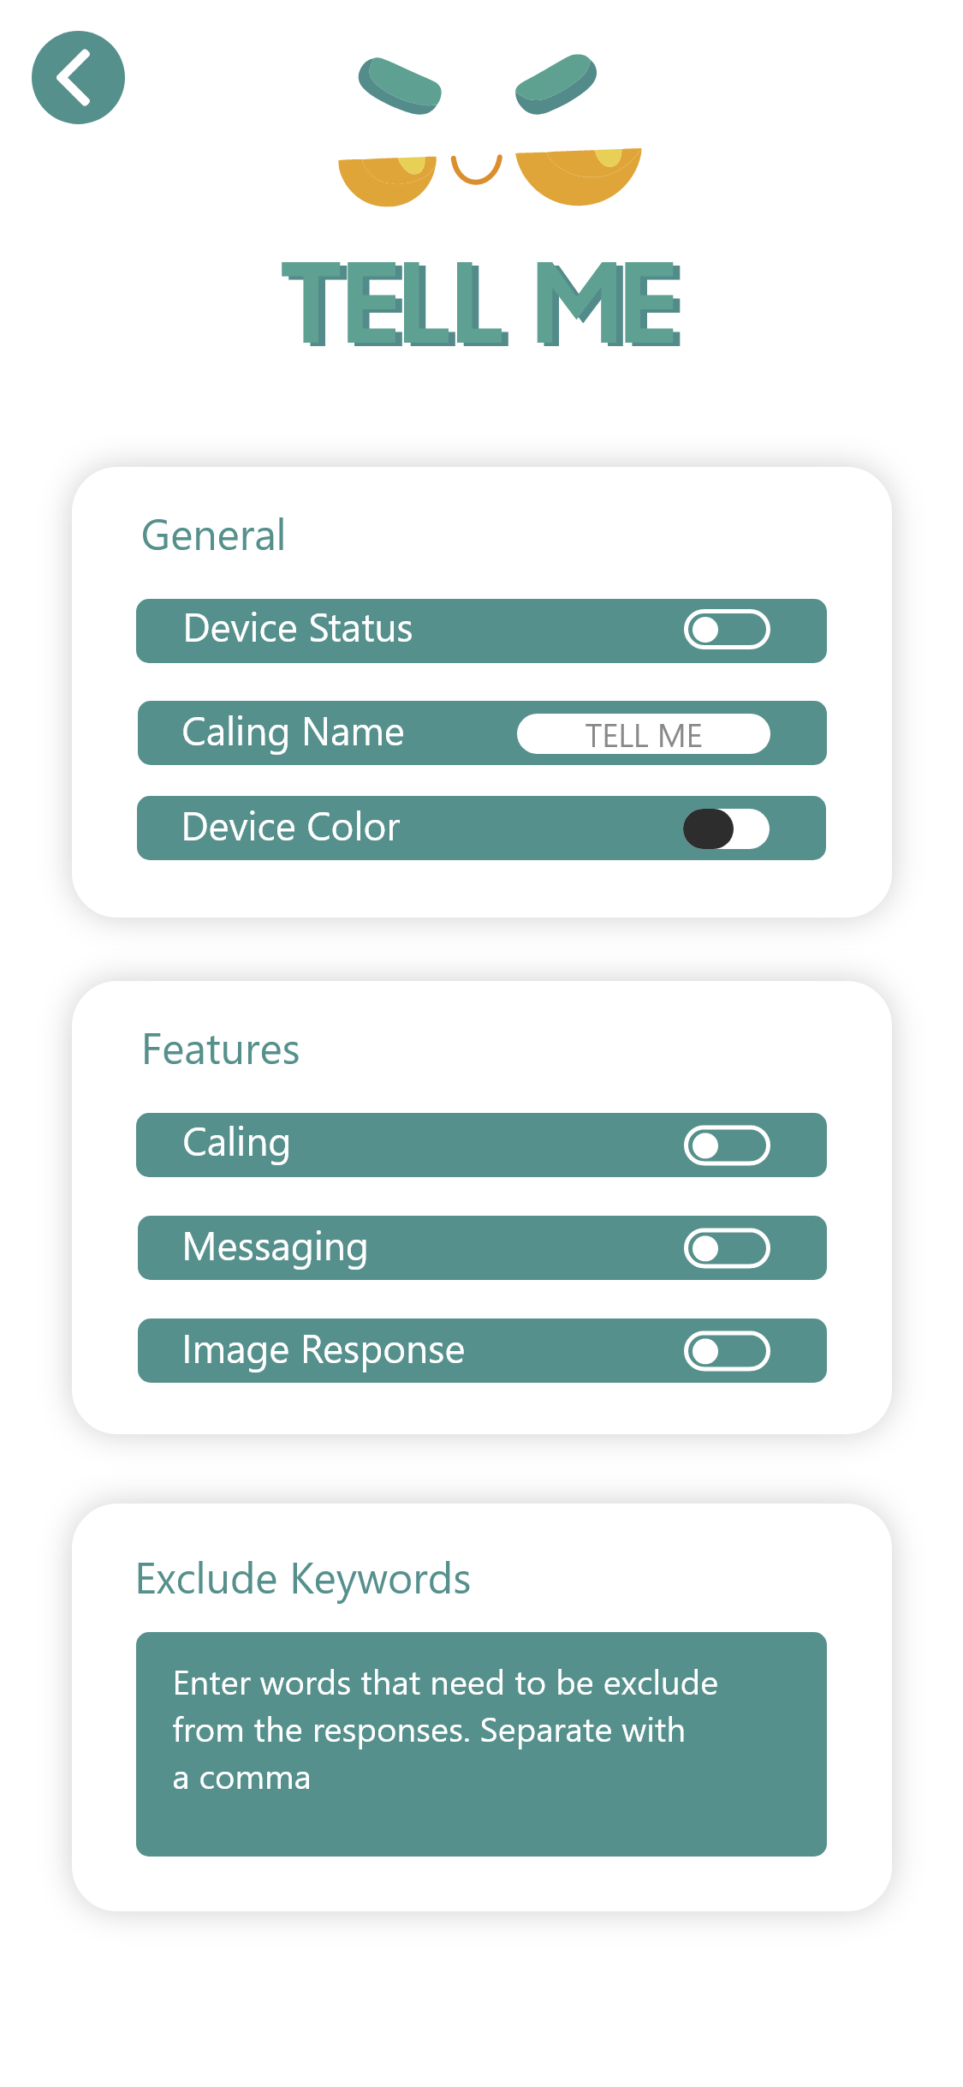

01
Introduction
Of “ TELL ME ”

Slide 4

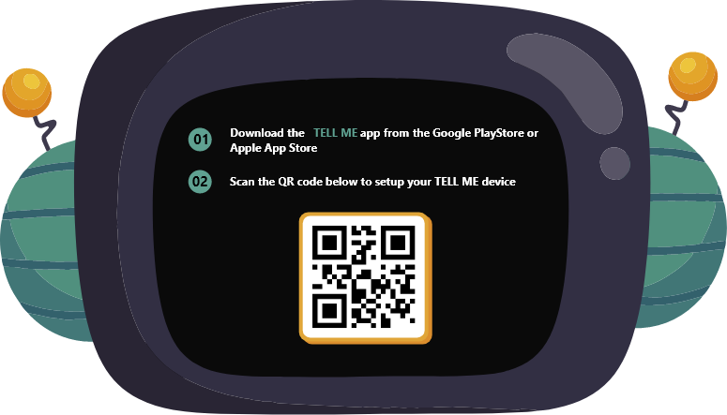
What is the “ TELL ME ” ?
This is a Voice enabled digital assistant that answer random questions of a Kids from age 05 – 13 , and provide age personalized answers audibly and visually.
And TELL ME is inter connected with mobile application

Slide 5
What are the Requirements of “ TELL ME ”
08
07
Functional Requirements
Non-Functional Requirements

Slide 6
Functional Requirements
1. Voice Interaction
The device must understand and respond to voice commands and questions from kids ages 5-13
It should provide accurate and age-appropriate responses.
It should support natural language understanding to interpret a wide range of queries.

Slide 7
Functional Requirements
2. Content and education
The device should offer educational content and activities suitable for different age groups.
It must encourage learning, creativity, problem-solving through lessons and activities.

Slide 8
Functional Requirements
3. Customization
Users should be able to personalize the app with different voices, avatars, and preferences.
Customization options should be age appropriate and user-friendly

Slide 9
Functional Requirements
4. Real-time location tracking
The device should provide real-time GPS-based location tracking for child safety
Parents should have ability to monitor their child’s location through a secure interface

Slide 10
Functional Requirements
5. Parental control
Implement parental control features that allow parents to restrict content, set time limits, and monitor usage
Ensure the security of these controls to prevent unauthorized access

Slide 11
Functional Requirements
6. Multi-language support
The device should support multiple language to cater to a diverse user base

Slide 12
Functional Requirements
7. Safety features
Include SOS or emergency calling function that connects the child with trusted contact in case of an emergency.
Ensure that the device can provide information to handle in unsafe and danger situations.

Slide 13
Functional Requirements
8. Compatibility
Ensure compatibility with various devices, including smart phones, tablets and IoT devices.

Slide 14
Non-Functional Requirements
1. Performance
The device should respond quickly to voice commands and provide timely and real time information
It must have minimum latency in processing requests.

Slide 15
Non-Functional Requirements
2. Scalability
The device should be able to handle a growing number of users and a content without significant decrease of performance

Slide 16
Non-Functional Requirements
3. Security
Ensure robust security measures to protect user data, especially children’s personal information
Implement encryption, secure authentication and data access controls

Slide 17
Non-Functional Requirements
4. Privacy
Adhere to strict privacy standards for handling children’s data
Clearly communicate data and privacy policy to parents

Slide 18
Non-Functional Requirements
5. Reliability
Minimize downtime and ensure high availability to provide a consistent user experience
Implement backups and recovery mechanisms to safeguard against data loss.

Slide 19
Non-Functional Requirements
6. Usability
The device’s user interface must be intuitive, visually appealing, and easy for children to navigate
It should provide clear instructions and feedbacks

Slide 20
Non-Functional Requirements
7. Accessibility
Ensure the device is assessable to children with disabilities, including those with visual and auditory impairments.

Slide 21

Technical
feasibility
studies

Slide 22
Introduction
This technical feasibility assesses the practicality of developing a voice-enabled digital assistant for children age 05 - 13. This aim to provide a portable, user-friendly, and educational tool that caters to the need of users.
Key features include a small display, GSM module for communication, Bluetooth/Wi-Fi setup, GPS location tracking, calling, texting, and SOS emerging calling function.

Slide 23
Hardware requirements
Software Requirements
Technical Requirements

Slide 24
Hardware requirements
Microphone and speakers for voice interaction
Small displays for visual feedback
GSM module for calling and texting capabilities
GPS units for location tracking
Power source and battery management solutions.

Slide 25
Software requirements
Operating system for device management
Speech recognition software for understanding spoken language
Natural language processing software for interpreting questions
Communication protocols for data exchange
Internet and network infrastructure for connectivity

Slide 26
> Display Integration A small display is integrated into the device, providing in addition to audible responses. > Bluetooth/Wi-Fi Setup Devices can be set up and configured using Bluetooth or Wi-Fi connectivity for user convenience. > GPA Location Tracking The system employs GPS technology to track the real-time location of the device, ensuring the safety of children.
Features and Functionalities

Slide 27
> Calling and Texting The system allows children to make calls and send messages to pre-approved contacts, enhancing communication and safety. > SOS Emergency calling In case of emergencies, an SOS feature is incorporated to quickly connect children with designated contacts..
Features and Functionalities

Slide 28
User Flow Diagram

Slide 29
Strengths
Weaknesses
Threats
Opportunities
SWOT analysis

Slide 30
Strengths
Cost-Effective
The app is either free to use or significantly less expensive compared to other products in the market, making it assessable to a wider range of users.
Portability
Its small form factor and inclusion of GSM module make it highly portable, allowing kids to use it on the go
Privacy-focused
The app does not track or profile users, ensuring the privacy and security of kids.

Slide 31
Strengths
Kid-friendly
The interface and content are designed specially for children, creating safe and engaging environment for them
Feature-Rich
The app offers a wide range of features, including voice assistance, DIY projects, and location tracking.
Educational
It provides age-personalized answers and encourage learning, helping children gain knowledge and develop new skills

Slide 32
Strengths
Real-time location tracking
The inclusion of GPS allows parents to monitor their child’s location, providing extra layer of security
DIY for older kids
Older children have the opportunity to engage in DIY projects and problem-solving activities, promoting independent learning and problem-solving skills
Customizable and Personalize
Users can personalize the app with different voices and avatars, making it more engaging and readable for individual children

Slide 33
Opportunities
Parent relief
The app can reduce the annoyance, that parents may feel when constantly bombarded with their child’s questions.
Educational development
The app can empower children to building things themselves, fostering a sense of independence and problem-solving skills.

Slide 34
Weaknesses
Internet Dependency
The app requires a stable internet connection to function properly, limiting its usability in poor connection areas
Battery dependence
Users need to charge the device regularly, which can be inconvenient, especially during long trips or outings.

Slide 35
Weaknesses
language limitations
The app may be limited in terms of supported languages.
Lack of context awareness
The app may not fully understand the content of a conversion, potentially leading to incorrect or irrelevant responses.

Slide 36
Threats
Competition
Existing products with larger user base like Amazon Echo Dot Kids, Chatterbox and HomePod Mini for Kids pose a threat, as they already have established market presence.
Safety concerns
The use of lithium-ion batteries in portable devices can pose fire hazards if not handled or designed properly, which may affect reputation and safety of product.
Technological advancement
Rapid technological advancements in the field of voice recognition and AI could make it challenging to keep the app up-to-date with the latest feature and capabilities.

Slide 37
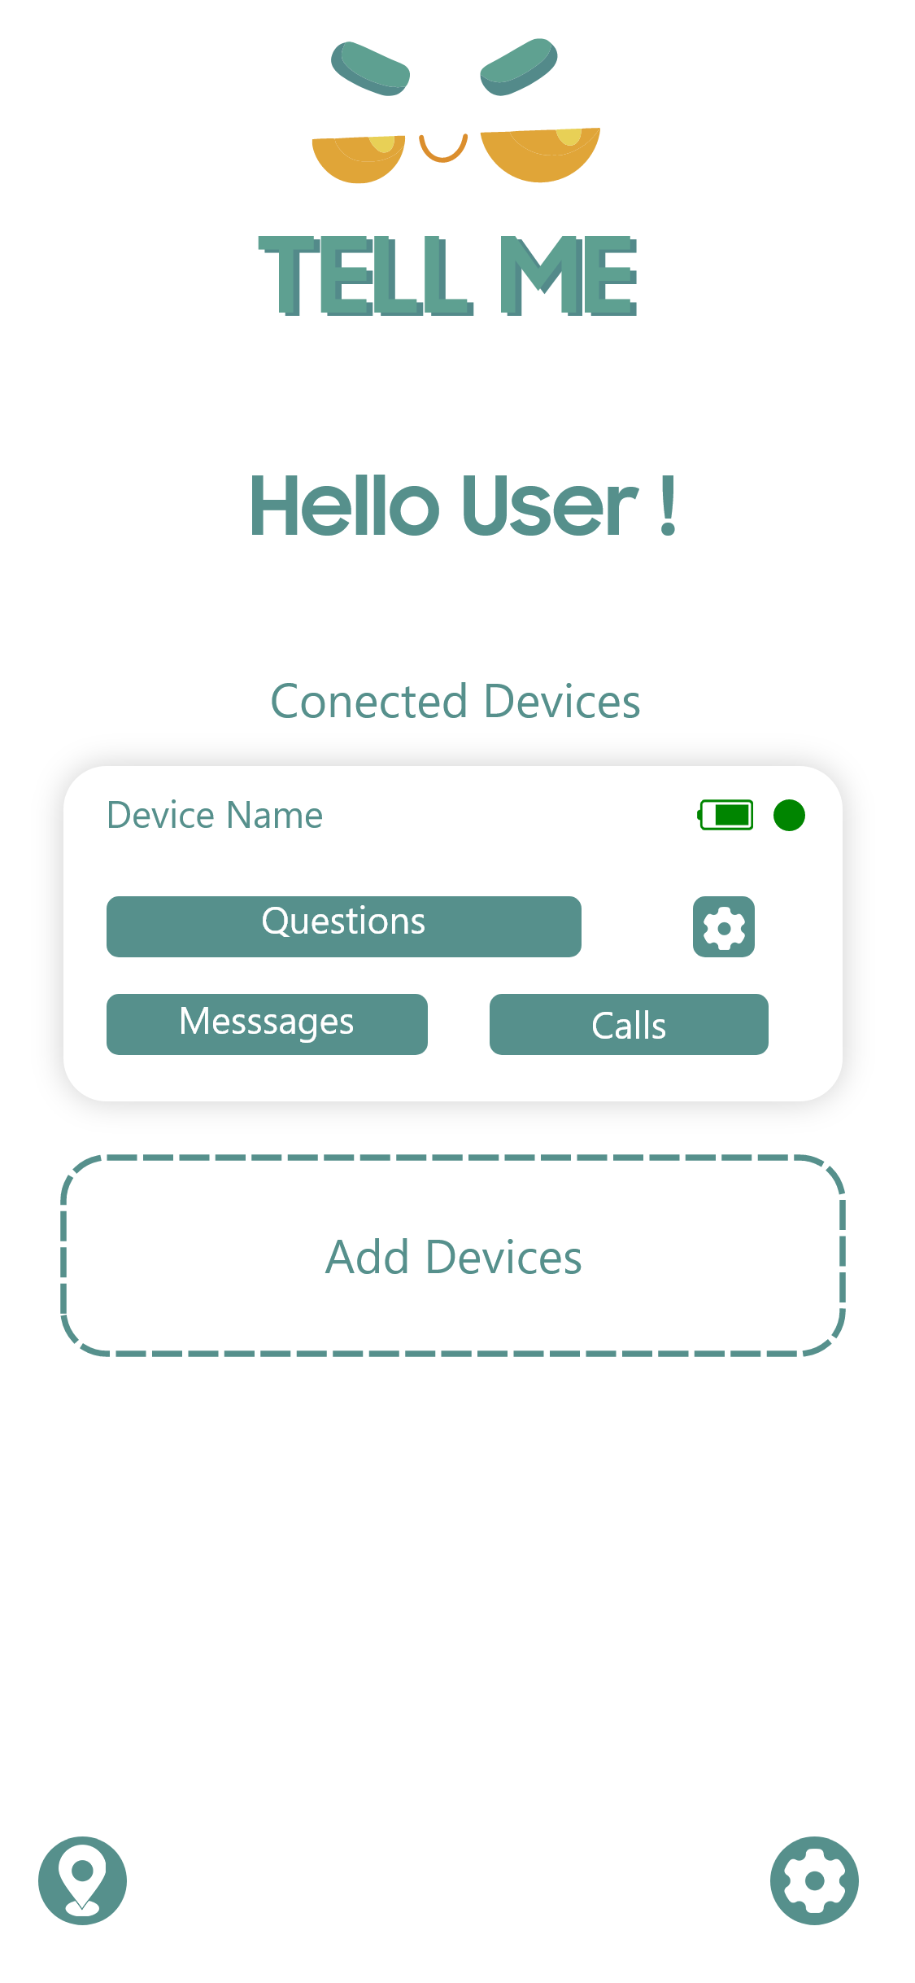
Target Audience Profiling
Primary users
Kids (age 5 - 13)
Secondary users
Parents / Caregivers

Slide 38
Kids ( age 05 – 13 )
Demographics :
Age : Children aged 5 – 13
Gender : Any
Social Backgrounds : Diverse social backgrounds, including various family structures and cultural backgrounds
Region : Residents in Urban areas in Sri Lanka
Education : Preschool to secondary school (Grade 1 to 8)
Job : Student / No occupation

Slide 39
Parents / Caregivers
Demographics :
Age : Aged between 25 - 45
Gender : Any
Social Backgrounds : Diverse social backgrounds, including various family structures and cultural backgrounds
Region : Residents in Urban areas in Sri Lanka
Income : Minimum Rs. 50,000 per month

Slide 40
Kids ( age 05 – 13 )
Psychographics :
Values :
Values fun and engaging interactions
Values learning and curiosity
Values content that aligns with their age and interests
Beliefs :
Believe in the importance of enjoyable learning experiences
Believe in the value of personalized and interactive content
Believe in content that adapts to their age and learning level

Slide 41
Kids ( age 05 – 13 )
Psychographics :
Lifestyle Choices :
Embrace a tech-savvy lifestyle
Exhibit a diverse range of hobbies and interests
Lead active, playful and exploratory lives
Goals :
Aim to learn, explore, and have fun
Seek age-appropriate educational experience
Have a secure and entertaining digital environment

Slide 42
Parents / Caregivers
Psychographics :
Values :
Values their child’s safety and privacy
Value educational and age-appropriate content
Value product that support their parenting efforts
Beliefs :
Believe in the significance of providing a safe and enriching digital experience for their child
Believe in the value of products with safety features and parental control

Slide 43
Parents / Caregivers
Psychographics :
Lifestyle choices :
Lead busy lives and seek products that make parenting easier
Value family timing and bonding
Goals :
Strive to provide their child with a safe and enriching digital experience.
Seek tools that support their child’s educational goals
Aim for balanced life

Slide 44
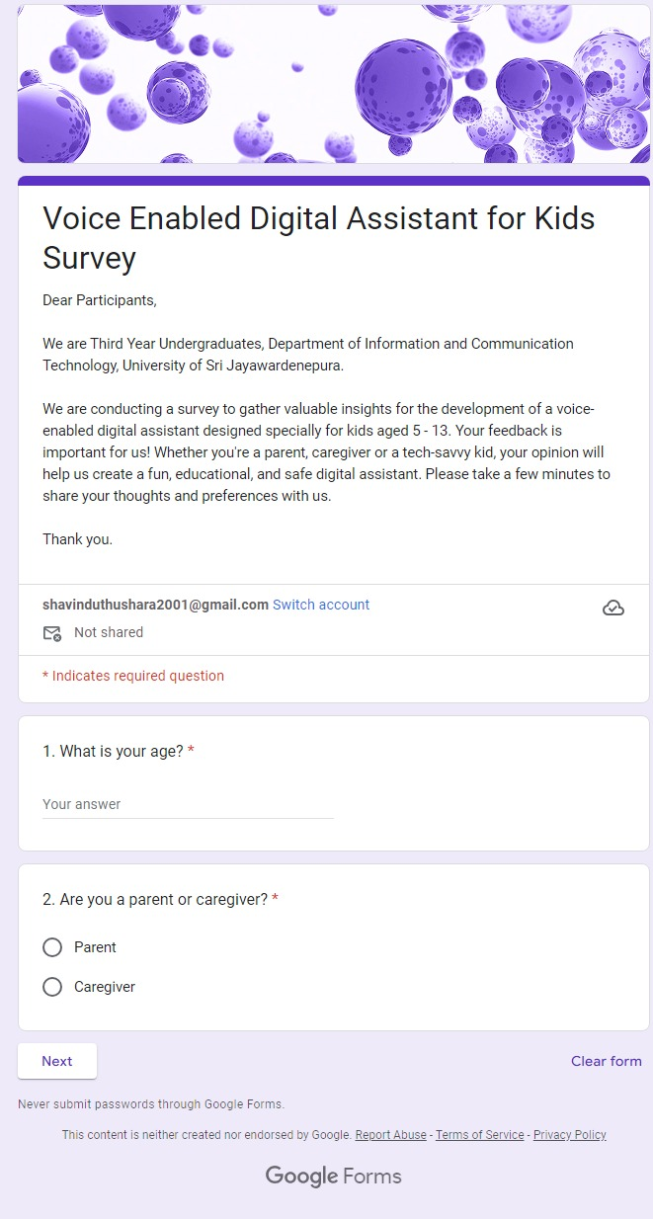
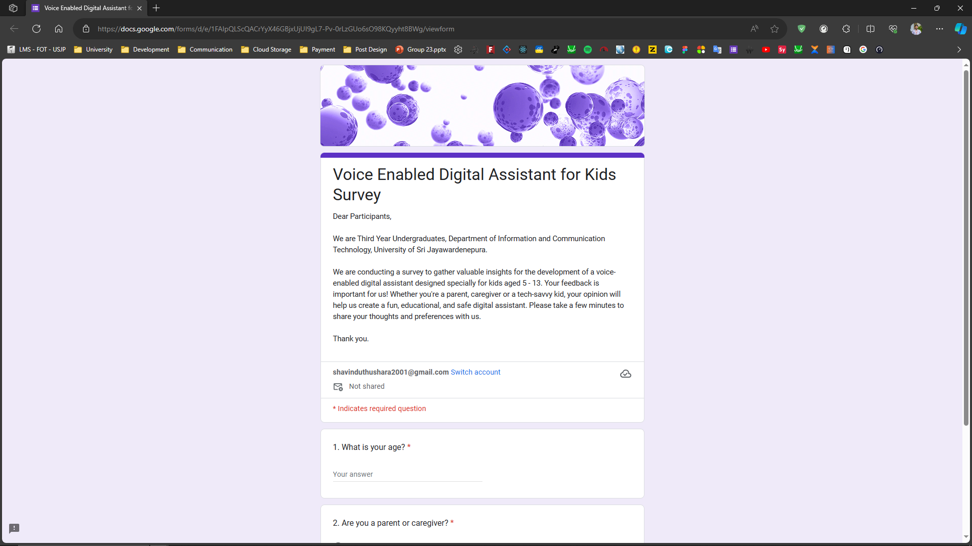
Questionnaire and the responses off google form or any other type of medium used
Google form :
Link :
https://forms.gle/nPBc3TdURnXG5gG2A

Slide 45
Wireframes of the Design
Device
Wireframes
Mobile Application
Wireframes

Slide 46
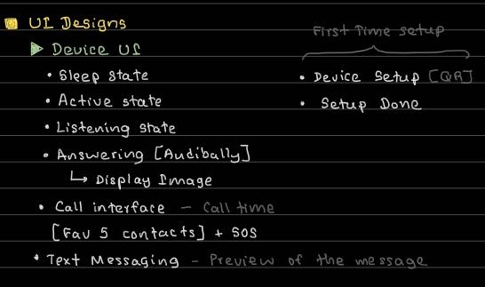
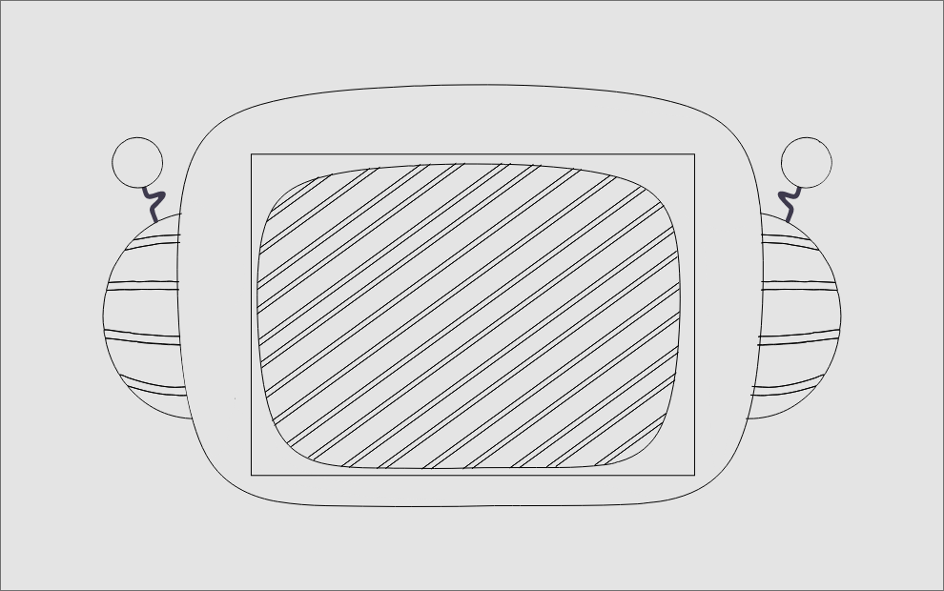
Device Wireframe

Slide 47
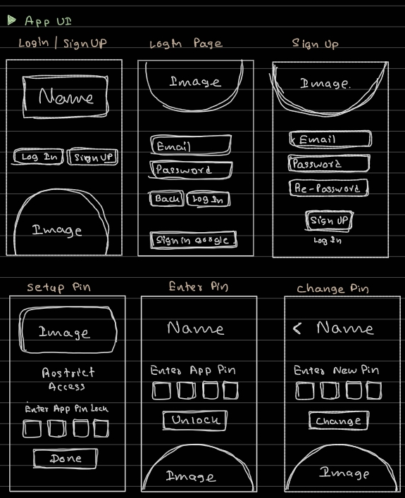
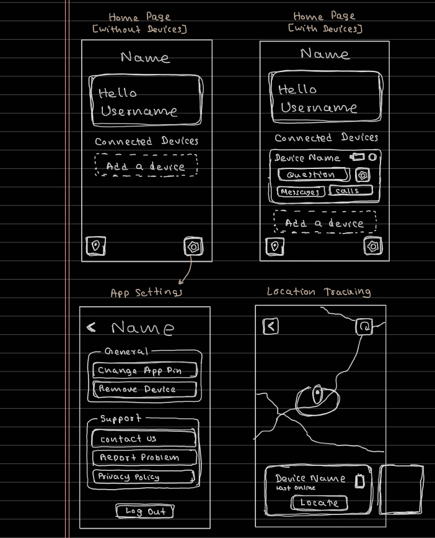
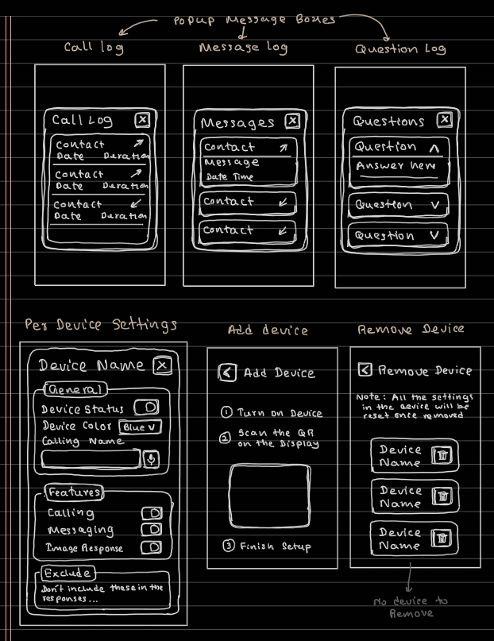
Mobile Application Wireframes

Slide 48
UI Designs
Device
Ui Designs
Mobile Application
Ui Designs

Slide 49
Device Ui Designs

Slide 50
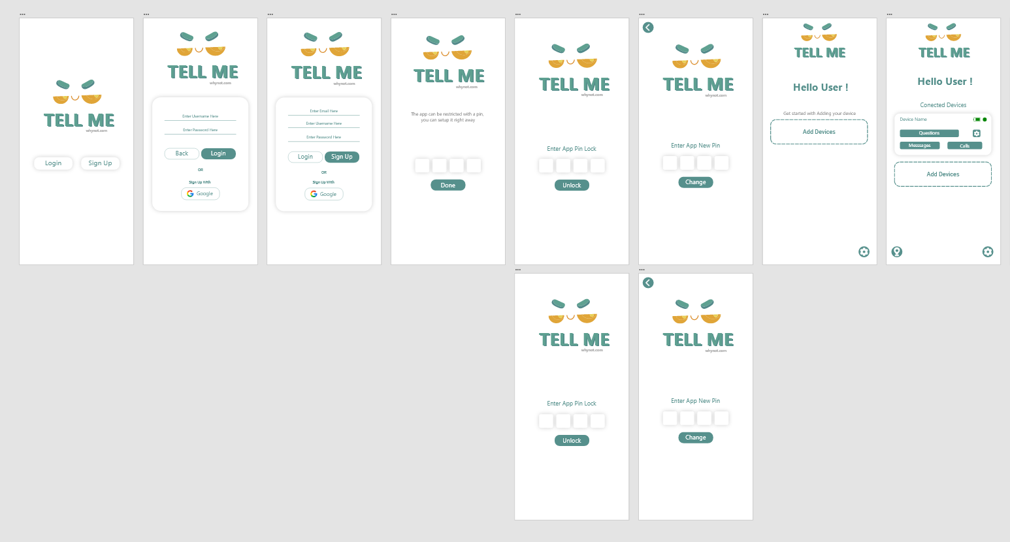
Mobile Application Ui Designs

Slide 51
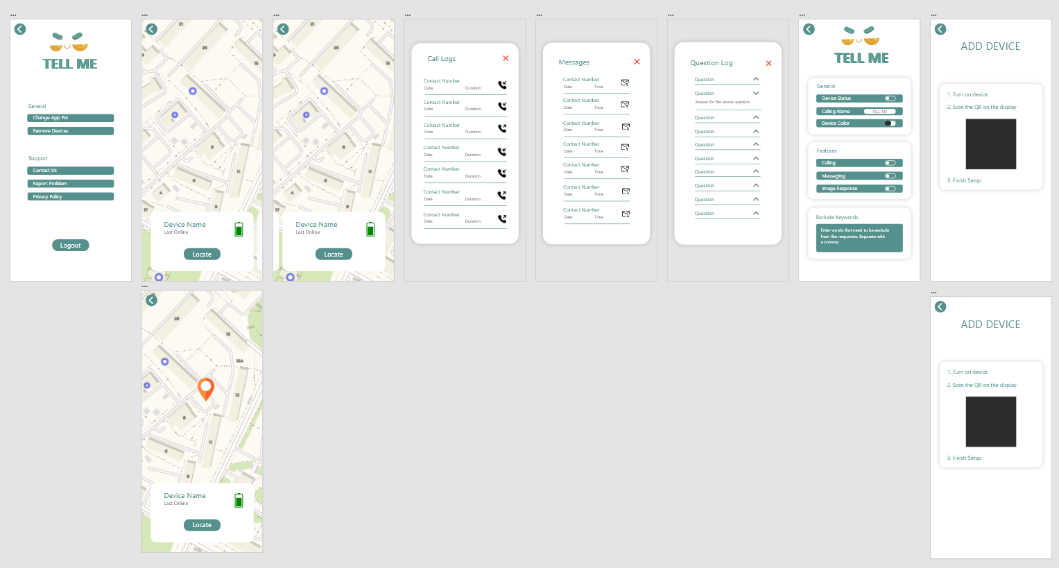
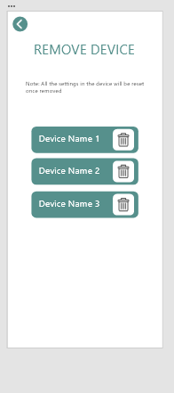
Mobile Application Ui Designs

Slide 52
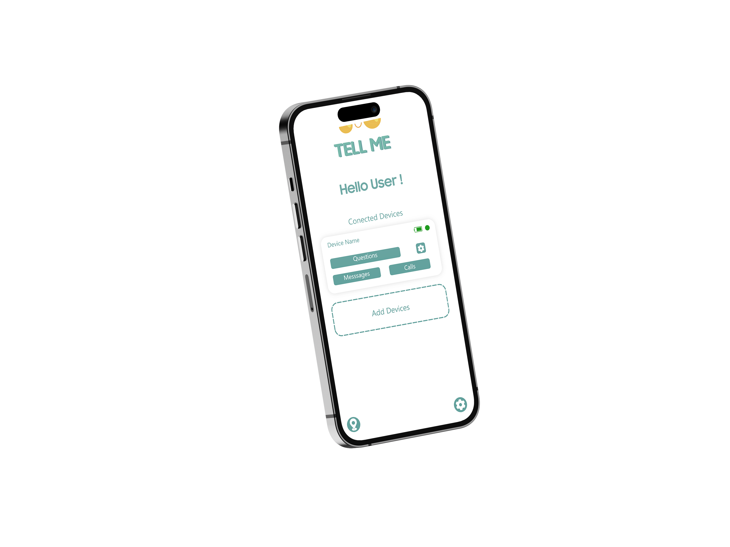
Prototypes Example

Slide 53


Slide 54
Thank You.

